Slide 1
BLINKIT ANALYSIS PROJECT
OVERVIEW REPORTS
KAMORE MAUREEN

Slide 2
PROJECTS STEPS
Figure Out The Business Requirements.
Data Walkthrough.
Data Connection.
Data Cleaning.
Data Modelling.
Data Processing.
DAX Calculation.
Dashboard Layout.
Charts Development and Formatting.
Report Development.
Insights Generations.

Slide 3
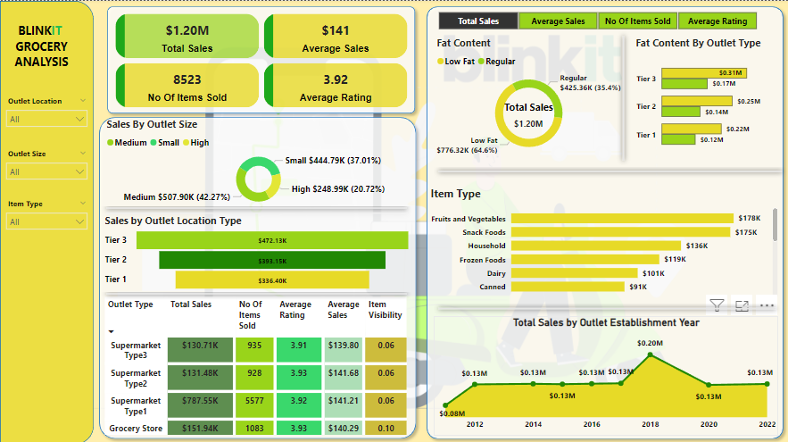

Slide 4
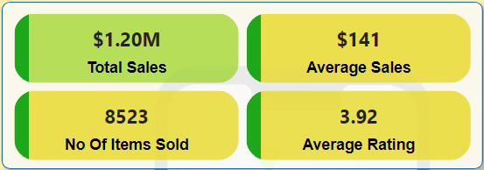
Overview Of Key Metrics
To conduct a comprehensive analysis of the BlinkIt Analysis sales performance, customer satisfaction and inventory distribution we must identify various KPIs
Total Revenue Generated : $1.20M
Average Revenue Per Sale : $141
Number Of Items Sold: 8523
Average Customer Rating For Items Sold : 3.92

Slide 5
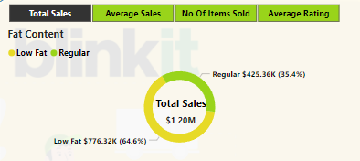
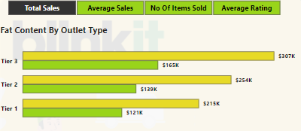
KPI METRICS ANALYSIS
KPIs Metrics By Fat Content (Total Sales)
Analyze the impact of fat content on KPIs metrics.
Low Fat Content: $776.32K (64.6%)
Regular Fat Content: $425.36K (35.4%)
KPIs Metric By Fat Content , Different Outlet Type (Total Sales)
Compare KPIs metrics across different outlets by fat content
Tier 3; Low Fat Content $307K, Regular Fat Content: $165K
Tier 2; Low Fat Content $254K, Regular Fat Content: $139K
Tier 1; Low Fat Content $215K, Regular Fat Content: $121K

Slide 6
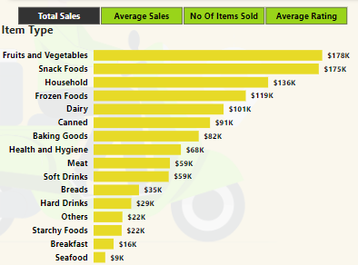
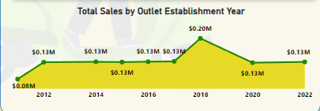
KPIs Metrics By Item Type (Total Sales)
We get to see how each item type performs in terms of total sales. Also analyze across the KPIs metrics..
Top 5 Performing Item Types
Fruits and Vegetables : $178K
Snacks Foods : $175K
Household Goods :136K
Frozen Foods : $119K
Dairy Products :$101K
Total Sales Over The Outlet Establishment Year
We get to analyze how the age of the establishment influences the total sales.
We can see the outlets established in 2018 have a total revenue of about $0.20M. Did really well compared to other outlets.

Slide 7
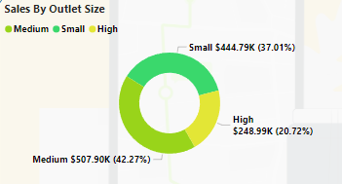
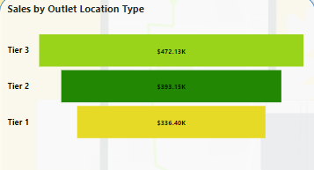
Total Sales By Outlet Size
We get to analyze the correlation between the outlet size and the revenue.
Medium Size: $507.90K
Small Size: $444.79K
High Size:$248.99K
Total Sales By Outlet Location Type
We get to analyze the geographical distribution of sales across different location type
Tier 3: $472.13K
Tier 2: $393.15K
Tier 1: $336.40K

Slide 8
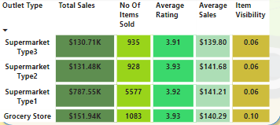
Matrix Card Of All Key Metrics By Different Outlet Type
This provides a comprehensive view of the KPIs plus item visibility broken down by different outlet types.
Supermarket Type 1 has a total revenue of $787.55K as well has a higher number of items sold(5577).

Slide 9
Conclusions And Recommendation
Conclusions
Medium sized outlets in Tier 3 locations are the most profitable.
Fruits and Vegetables and Snack Foods are top performing item types.
A majority of sales come from low-fat content items.
Recommendations
Focus on expanding the medium sized outlets in Tier 3 locations.
Increase the inventory of the top performing items that is fruits and vegetables, snacks foods.
Decrease or stop stocking up the inventory of the poor performing items that is sea foods.
Invest in marketing low fat products aggressively.
We need to explore why the sales peaked in 2018 established outlets and strategies to replicate that success.

